Slide 1
Thermal Noise and Design of the GQuEST Interferometer
Daniel Grass

Slide 2
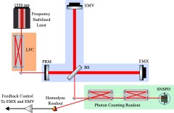
GQuEST Setup
Notes:
Focusing on blue part of the detector
We are particularly sensitive to noise sources here because of the high power

Slide 3
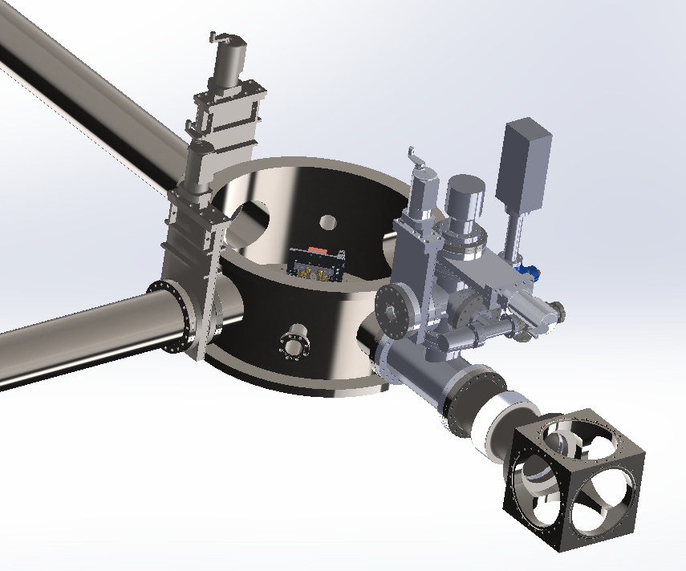
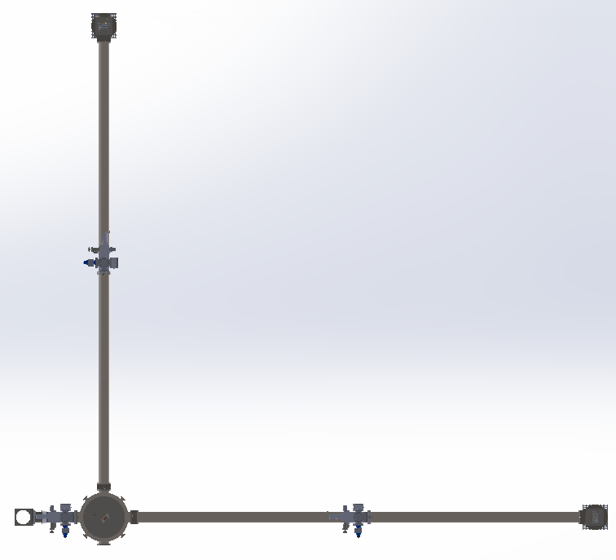
Actual Design

Slide 4
Noise Budget
This “noise budget” contains the dominant noise sources in the GQuEST interferometer
We are dominated by bulk thermal noise from the optics

Slide 5
Solid Normal Mode Noise
Each mirror has tiny vibrations, which change the measured length of the arm
2 ways of calculating the noise: susceptibility method and eigenmode decomposition

Slide 6
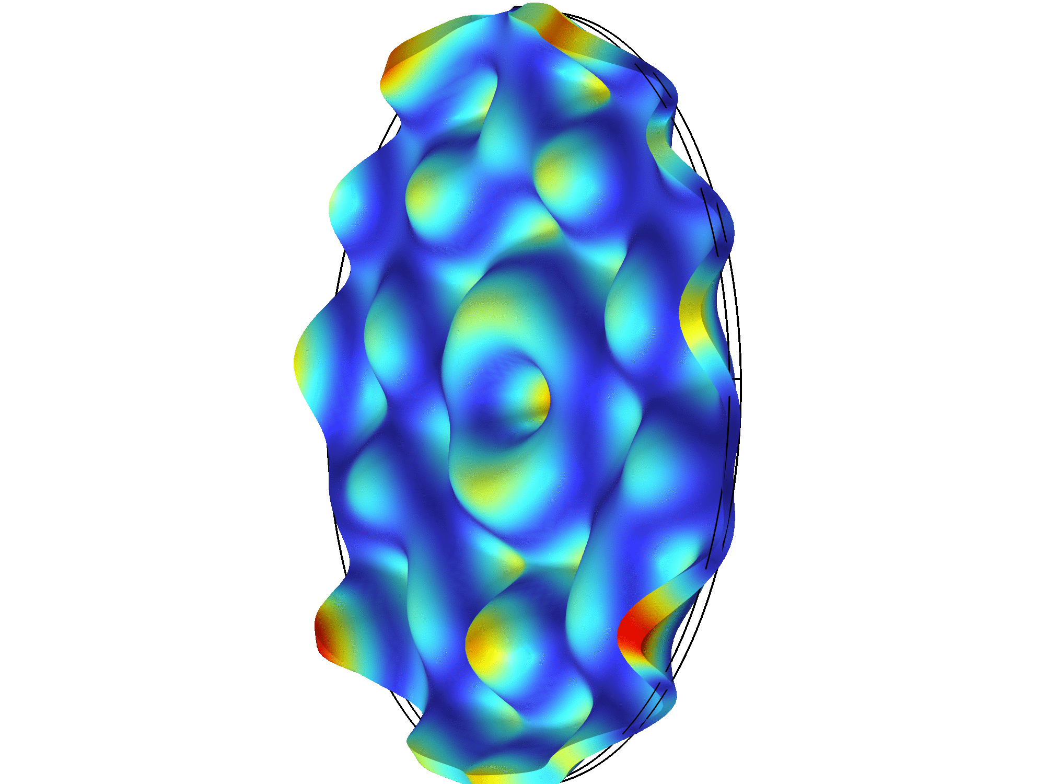
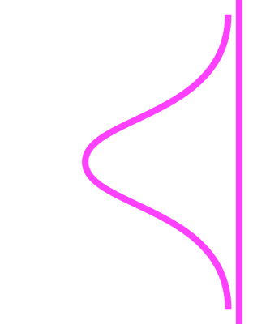
Solid Normal Modes
=

Slide 7
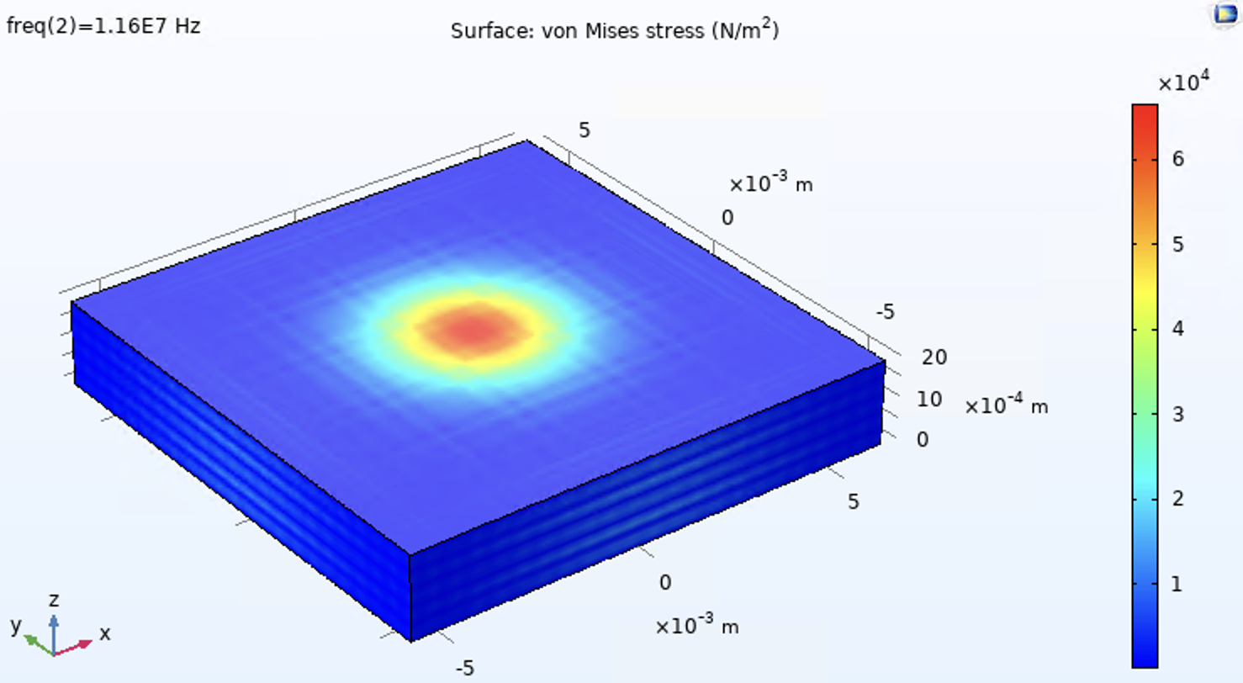
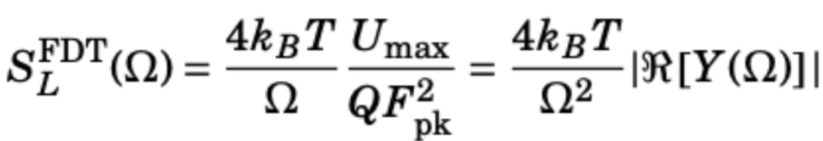
Susceptibility Method
Solid Normal Noise can be modeled by treating the laser as a force and considering the power dissipated, “susceptibility method”
This relies on the fluctuation-dissipation and equipartition theorems
Uses the “admittance” from the laser beam modeled as a force
Easier computationally, but less direct

Slide 8
More on the Susceptibility Method
Admittance = 1/impedance
The real part is the dissipative term, like a resistance
This is similar to Johnson-Nyquist noise

Slide 9
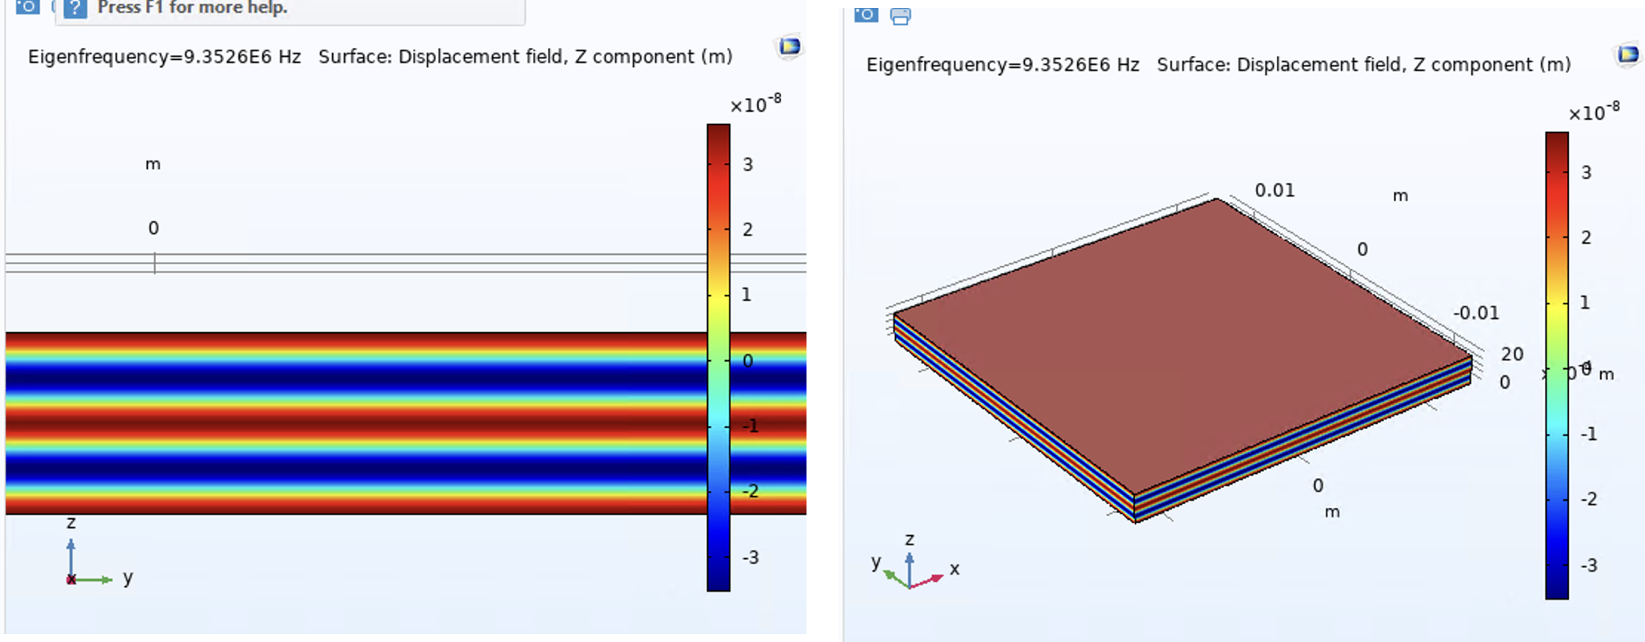
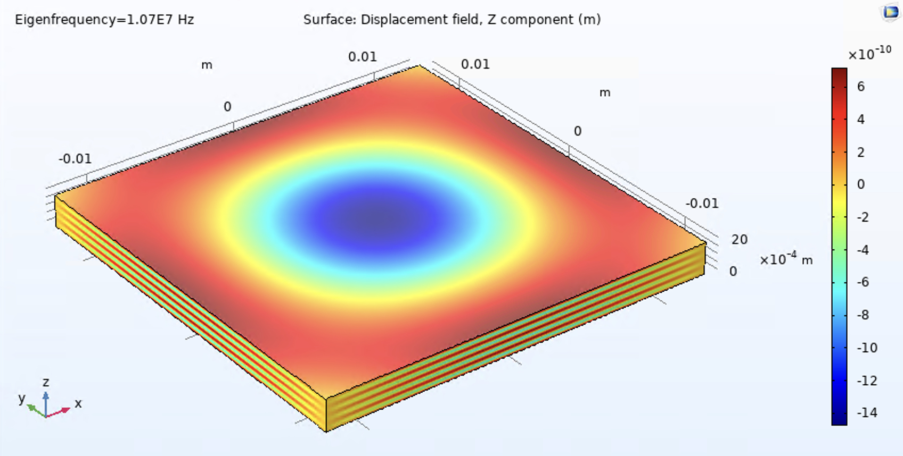
Eigenmode Decomposition Theory
The mirror has (many) eigenmodes
Each eigenmode displaces the mirror surface, which affects the phase of the light and looks like signal
The strength of the noise from each eigenmodes is proportional to the overlap integral of the beam and the eigenmode
Equipartition Theorem used here as well

Slide 10
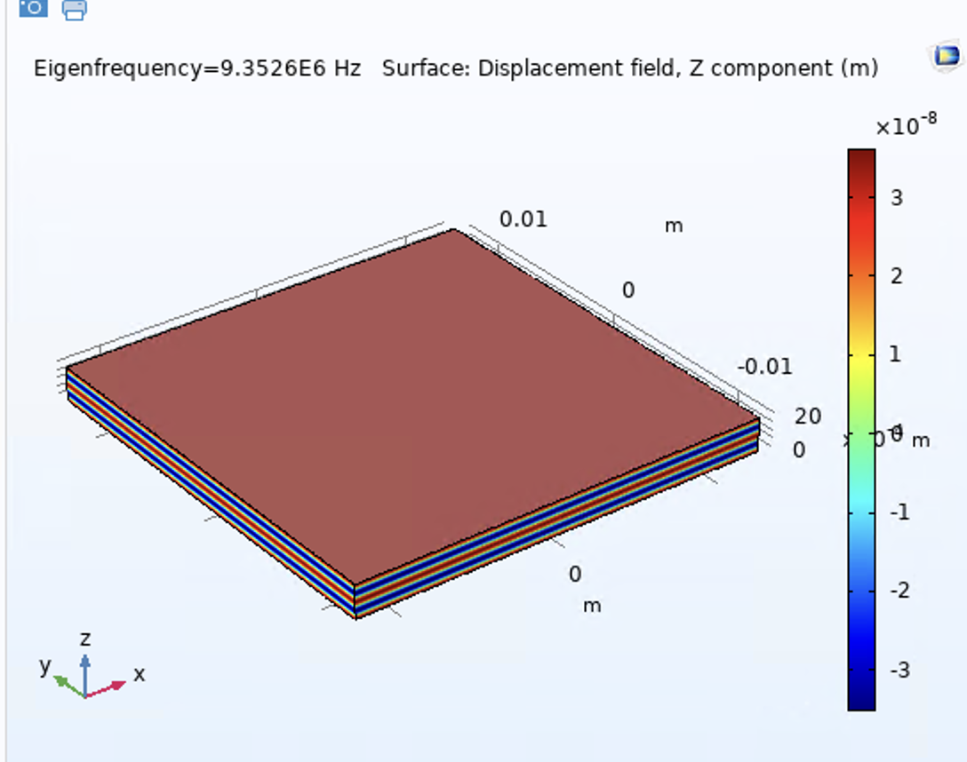
What are these modes?
Longitudinal (scalar potential)
Transverse (vector potential)

Slide 11
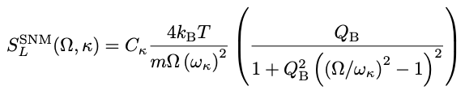
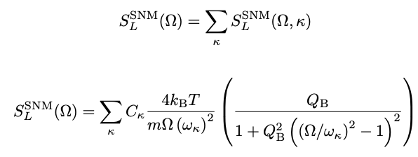
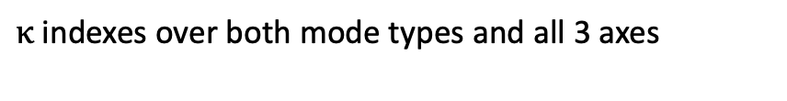
Eigenmode Decomposition Math
$κ$ indexes over both mode types and all 3 axes
Notes:
Starting point: power spectral density from the fluctuation dissipation theorem

Slide 12

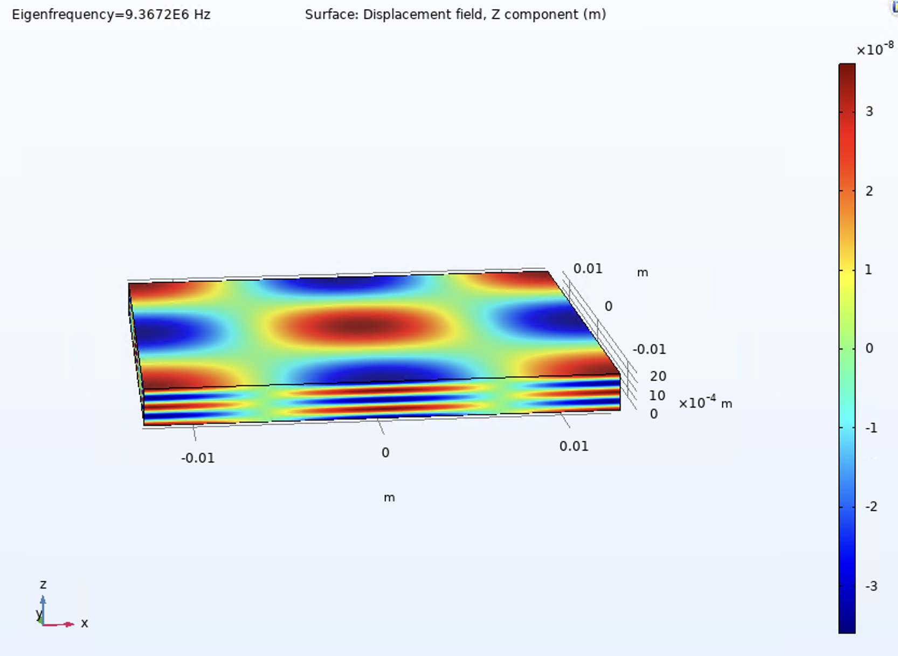

What is the coupling for longitudinal modes?
(I,J,K) = (2,2,4)

Slide 13
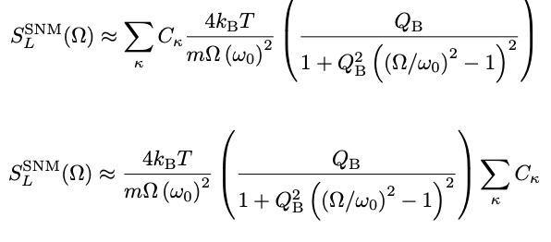
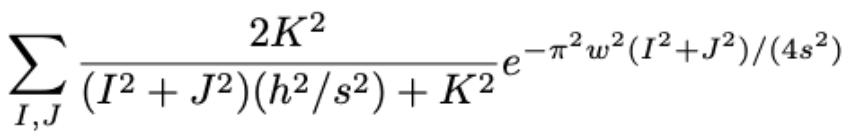
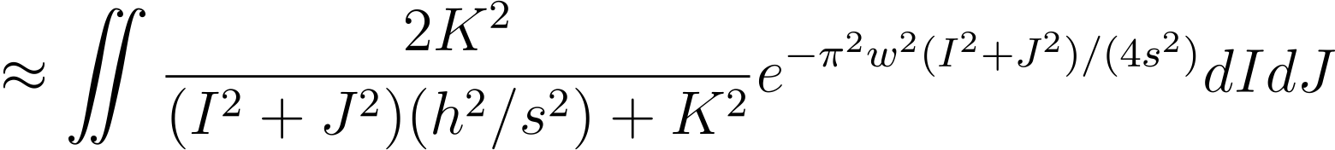
Analytic Estimation for constant K
Notes:
To estimate analytically, consider a bunch of modes near a resonance
Sum over PSDs
If treat as same frequency, then this is a sum over couplings alone
Convert sum to integral
Now we have the noise a little away from each resonance

Slide 14
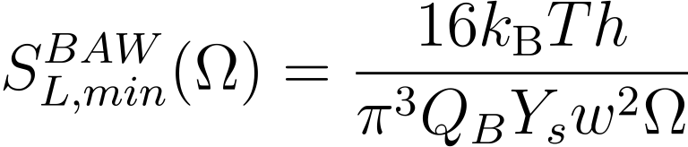
Final Analytic Estimation
Consider noise half-way between resonances, which is where we will look for the signal
Evaluating the integral from the last slide and doing some algebra yields the following

Slide 15

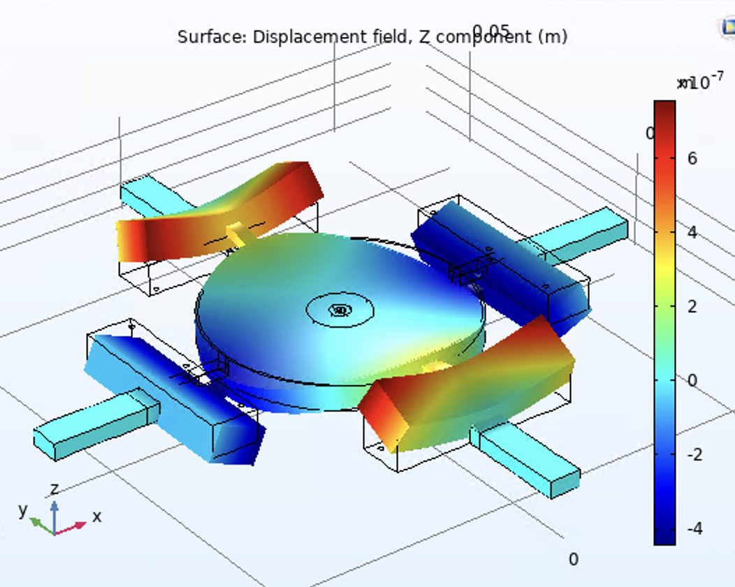
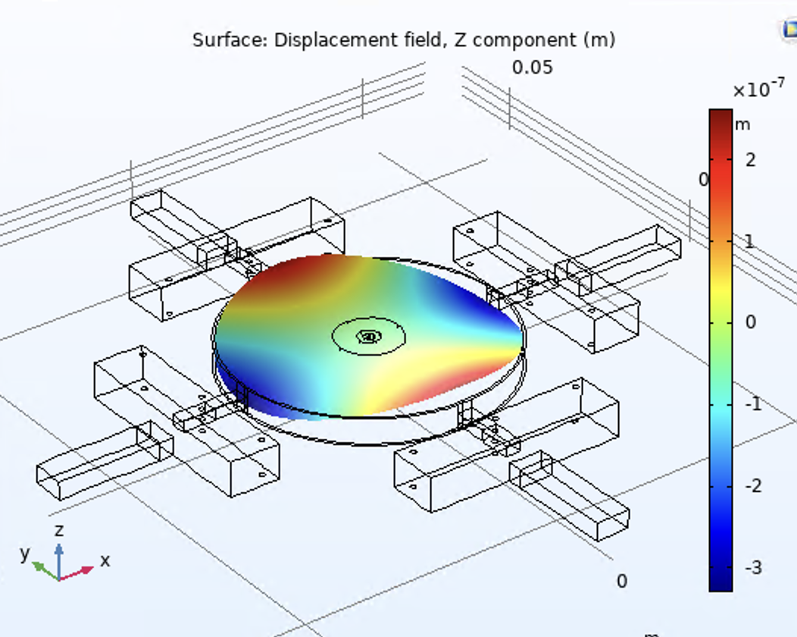
Limit 1 on SNM minimization
Optic cannot be too thin, or coating stress becomes too problematic

Slide 16
Limit 2 on SNM minimization
Optic cannot be too stiff, or modes with transverse components couple in at higher frequencies

Slide 17
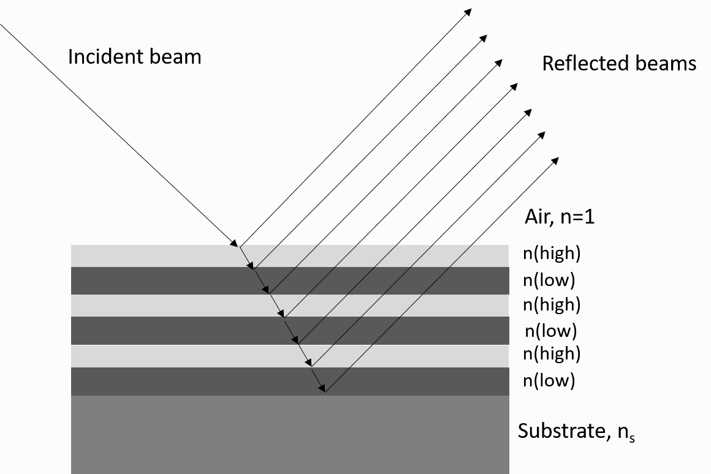
Coating Thermal Noise
Need a coating on an optic to make it reflective
Often very thin and made up of alternating layers, a “Bragg coating”
Brownian noise is due to mechanical fluctuations, just like the bulk thermal noise, but the coating layer is much thinner so this noise presents differently
(https://www.emf-corp.com/optical-coatings/dielectric-bragg-mirrors/)

Slide 18
High Frequency Coating Thermal Noise
Almost all existing work has been done is a quasistatic limit, where the measurement frequency is much less than the first bulk eigenmode
Have a basic model of how to unify coating and bulk thermal noise

Slide 19
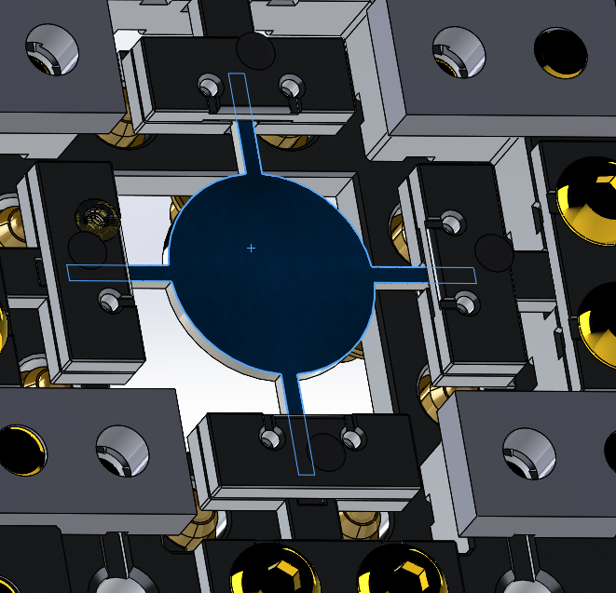
Design Implications
Bragg Coatings have a low Quality Factor
This is a fundamental limit on the combined quality factor for the whole mirror
Goal for us is to hold the optic with less dissipation than in the coating

Slide 20
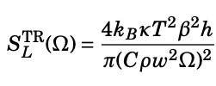
Thermorefractive Noise
The index of refraction of silicon, like many materials, is temperature dependent
The index of refraction changes the optical path length of the transmitted arm
Optics have microscopic temperature fluctuations due to diffusion
Noise is present where the light goes through an optic, so just the beamsplitter

Slide 21

Charge Carrier Thermal Noise
Similar to thermorefractive noise, except here the index of refraction depends on the density of charge carriers, i.e. electrons
This noise source is constant in frequency up to 200 GHz, although it also experiences the beam splitter transfer function

Slide 22
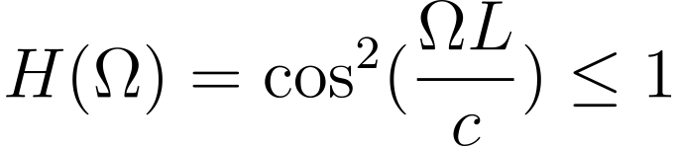
Beam Splitter Transfer Function
Property inherent to Michelson Interferometer: noise and signals at the beam splitter (very nearly) go away at the FSR (1/light travel time) of the arms
Can be derived by considering the how light with different phase gets recombined at the beamsplitter

Slide 23

Thermoelastic noise
Similar to thermorefractive noise, but now we are considering the coefficient of thermal expansion instead of the thermorefractive coefficient
Present at all optics

Slide 24
Noise Budget (again)

Slide 25
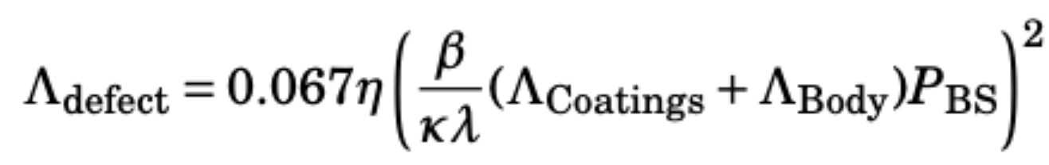
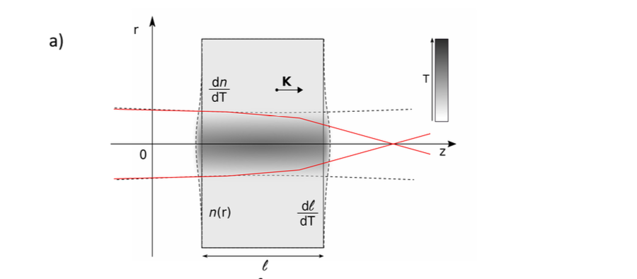

Thermal Lensing
Not a noise source but an important technical limitation
The beam splitter absorbs some of the 10 kW going through it
This introduces a temperature gradient
Due to the temperature dependence of the index of refraction, this effect lenses light going through the beam splitter
Need light that is reflected and transmitted to “mode match”
Simonelli et al, 2019

Slide 26
Why Silicon?
High thermal conductivity
Stiff
High Q at 17 MHz
Lots of R&D previously done
Good synergy with future detectors
Drawback #1: need use 1550 nm light
Drawback #2: semiconductor effects
Drawback #3: birefringence

Slide 27
Thank you!

